Slide 1
Summary of the
Supplemental Proposals to Revising the
Northern California Metroplex For
Alameda County/Contra Costa County
This IS a presentation given at the January 2017 OAKLAND Airport/Community Noise Management Forum meeting and is PROVIDED here AS AN INTRODUCTION TO THE FULL PROPOSAL DOCUMENT PROVIDED TO THE FAA BY THE IN MARCH 2017

Slide 2
Q. Why Were the Proposals Necessary?
A. “NextGen” in the East Bay
• The FAA’s Next Generation Air Transportation System (“NextGen”) was introduced to the East Bay in 2015. NextGen created new arrival and departure flightpaths and procedures for OAK and SFO.
• The changes significantly altered where planes flew, dispersion, altitude, and concentration of flights over Alameda and Contra Costa Counties.
• The result was significant noise impacts negatively affecting Alameda, Oakland, Berkeley, San Leandro and other areas, which had not experienced such impacts prior to NextGen.
• In response to resident’s complaints and the suggestion of the FAA, the Oakland Airport-Community Noise Forum agreed to work with its members and community noise groups to forward proposals to mitigate NextGen noise impacts.
• The proposals use objective data to minimize aircraft noise impact and to produce reasonable solutions that: maintain and increase aviation safety, respect and improve efficient fuel and airspace use, and create a fairer distribution of noise.

Slide 3
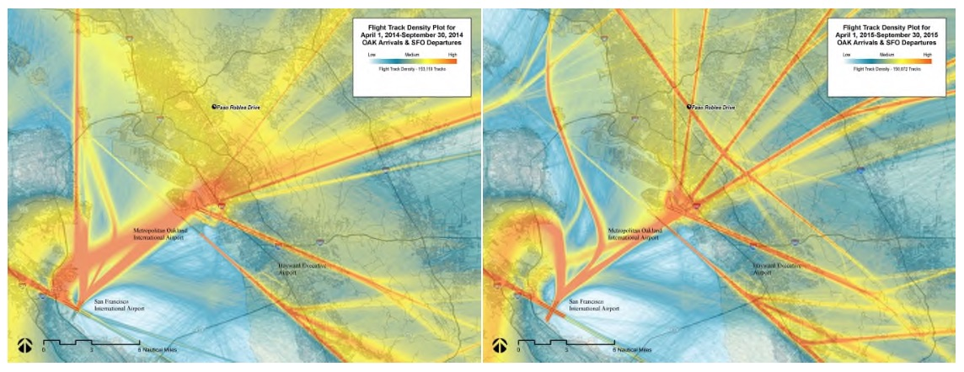
How NextGen Changed the East Bay
Pre NextGen April – September 2014
Post NextGen April – September 2015
The orange shading represents concentrated, high volume air traffic. NextGen took the previously better dispersed aircraft traffic and focused it into narrow corridors over the East Bay.
Montclair Flight Track Analyses, HMMH Inc., Technical Memorandum HMMH Project Number 302551.004, March 30, 2016

Slide 4
What is Addressed in the Proposals
Six NextGen related noise issues were identified in the East Bay caused by new arrival and departure tracks and procedures implemented by NextGen. Airplane arrivals and departures can be individually “vectored” by Air Traffic Control or follow specific published RNAV tracks to and from each airport. An RNAV track defines a specific repeatable route and altitudes for a plane to follow. Each one is given a distinct five letter name. Mitigation proposals are included for each of the identified noise issues for the FAA to review and respond to:
Oakland International Airport (OAK)
  HUSSH TWO Night Time Noise Abatement Departure
  WNDSR TWO North and Northeast Arrival Traffic
  OAKLAND NINE Departure
  CNDEL THREE Departure
San Francisco International Airport (SFO)
  NIITE THREE Night Time Noise Abatement Departure
  TRUKN TWO Departure
Noise issues for other counties in the Northern California Metroplex are being addressed independently from those in Alameda and Contra Costa Counties. The Northern California Metroplex is the area that includes San Jose Airport, Oakland Airport, San Francisco Airport and Sacramento Airport.

Slide 5
Terminology Used
• Waypoint – A specific geographic point defined by latitude and longitude only. No altitude is assigned it.
• Track - The path on the ground over which an aircraft flies.
• RNAV –A navigation method that allows aircraft to use satellite GPS to get from Point A to Point B. Each RNAV track is given a unique and distinctive five letter name to designate it.
• Vector – The directional heading Air Traffic Control issues to an aircraft to fly in.
• AGL – Above Ground Level – the distance from the ground to an aircraft in the sky.
• MSL – Mean Sea Level - the distance from average sea level to an aircraft in the sky.

Slide 6
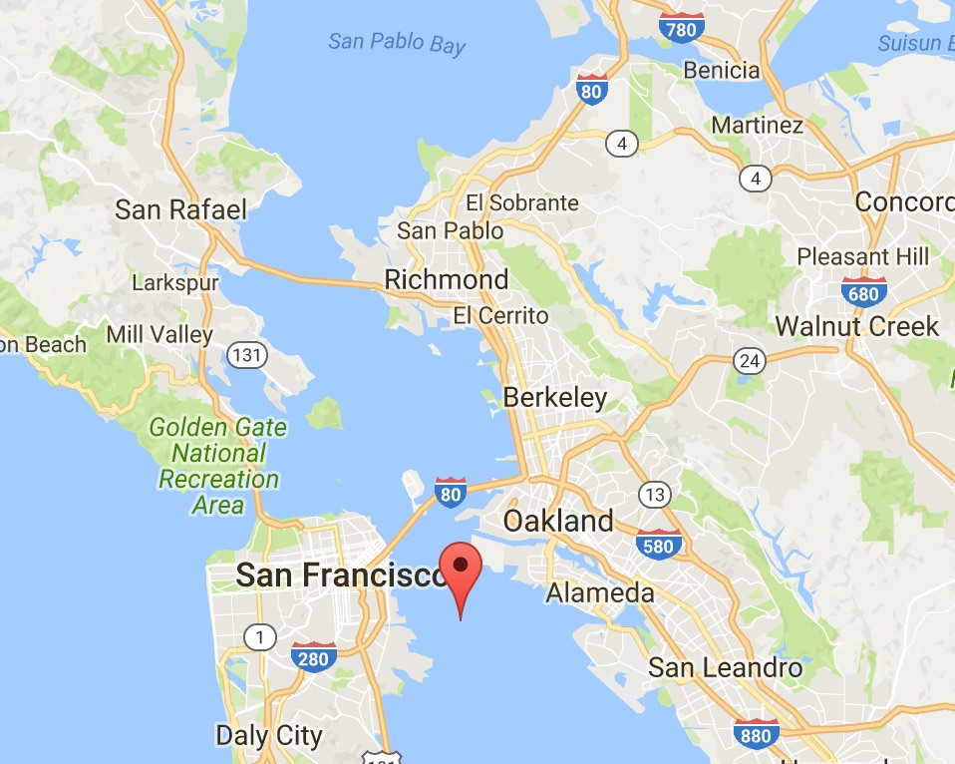

OAK Proposal
Modify the HUSSH Departure
HUSSH is the night time NextGen RNAV track to overlay the SILENT departure track used prior to NextGen.
Designed to minimize noise impact during night time hours by keeping planes over water until they reach higher altitudes at Pont Richmond and turn eastward.
Noise Issues:
HUSSH changed the departure by having aircraft fly closer to Bay Farm Island and Alameda than under the old SILENT procedure.
The majority of aircraft are granted early turns over densely populated Oakland, Berkeley and El Cerrito at much lower altitudes creating significant nighttime noise and circumventing noise abatement objectives.
REBAS
Intersection
HUSSH Waypoint
OAK
NOTE: Lines and waypoints on map are approximate representations of published charts.

Slide 7
OAK Proposal
Modify the HUSSH Departure
Proposed Short Term Solutions
• Air Traffic Control to individually assign departure headings for every aircraft that restore the beginning of the old SILENT track that kept planes further off-shore from Alameda.
• Air Traffic Control to keep aircraft on the HUSSH route as charted and not allow aircraft to turn eastward prior to the REBAS intersection where they are at higher altitudes unless safety dictates otherwise.

Slide 8
OAK Proposal
Modify the HUSSH Departure
Proposed Long Term Solutions
• Adjust the HUSSH waypoint southward to facilitate a sharper left turn.
• Issue an FAA Air Traffic Control directive that aircraft fly the full HUSSH departure
to REBAS for noise abatement purposes unless safety dictates otherwise.
• Adjust the REBAS waypoint location offshore to better mitigate noise at
Point Richmond.
• Adjust night time hours to provide a longer period of quiet hours for noise relief:
  Current: 10pm – 7am Monday through Saturday and 10pm – 8am on Sunday
  Propose: 9pm – 9am seven days a week
REBAS
Intersection
HUSSH Waypoint
OAK
NOTE: Lines and waypoints on map are approximate representations of published charts.

Slide 9
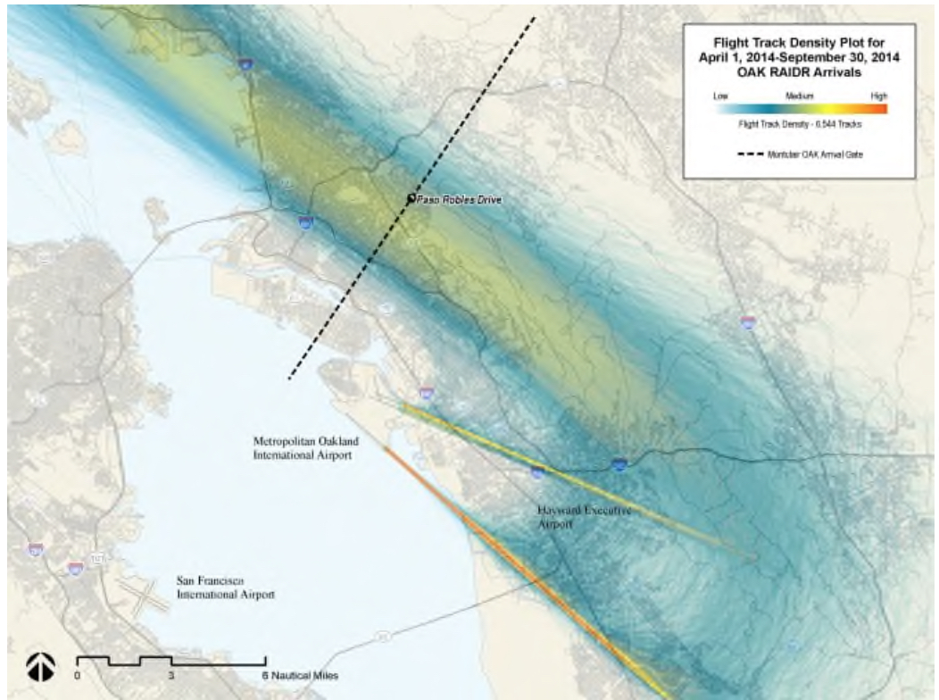
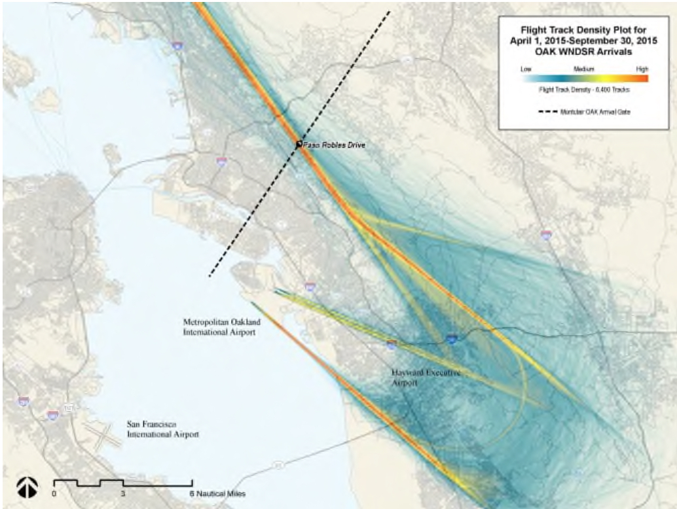
OAK Proposal
Move the WNDSR Arrival Track
WNDSR is the new NextGen track for aircraft arriving from the north and northeast into OAK.
BEFORE
NextGen
AFTER
NextGen
Traffic was dispersed over a wide area over 6 miles wide including the Bay prior to NextGen. NextGen shifted and concentrated traffic into a corridor less than 2000 feet wide over the topographically highest part of the East Bay.
Montclair Flight Track Analyses, HMMH Inc., Technical Memorandum HMMH Project Number 302551.004, March 30, 2016

Slide 10
OAK Proposal
Move the WNDSR Arrival
The Noise and Procedure Issues with WNDSR
• WNDSR shifted and concentrated traffic from a corridor over six miles wide to a track less than one-half mile wide over the topographically higher East Bay Hills. This resulted in dramatic noise impacts to densely populated residential areas. Daytime ambient noise levels are commonly less than 45dB.
• WNDSR requires level flight under power for over 23 nautical miles at altitudes commonly down to 3000 feet or less Above Ground Level. This is nosiest and most fuel intensive way to fly and creates polluting emissions.
• The current location of WNDSR can never deliver fuel efficient, idle power, quieter, glide descents that NextGen trumpets as it is constrained to keep airplanes low due to SFO departing traffic over it.
• Many aircraft must fly a considerable distance westward to pick up the WNDSR arrival track only to fly eastward again to merge into the OAK arrival procedure. WNDSR lengthens flight paths and reduces efficiency.

Slide 11
OAK Proposal
Move the WNDSR Arrival
Long Term Mitigation Solution
• Eliminate the current WNDSR track and replace it in an appropriate location that allows for geographically shorter flight paths and quieter, fuel efficient near idle-descent procedures into OAK called “Optimized Profile Descents” or “OPD’s.” This has a computer calculate an airplane’s descent using the most economical power setting, at or near at idle.
• Near idle OPD descent procedures reduce noise, save fuel, cut engine emissions and help ensure precise arrivals.
• Moving WNDSR eliminates potential safety hazards of traffic conflicts with departing OAK and SFO aircraft.
To accomplish this, the proposals include two alternatives.

Slide 12
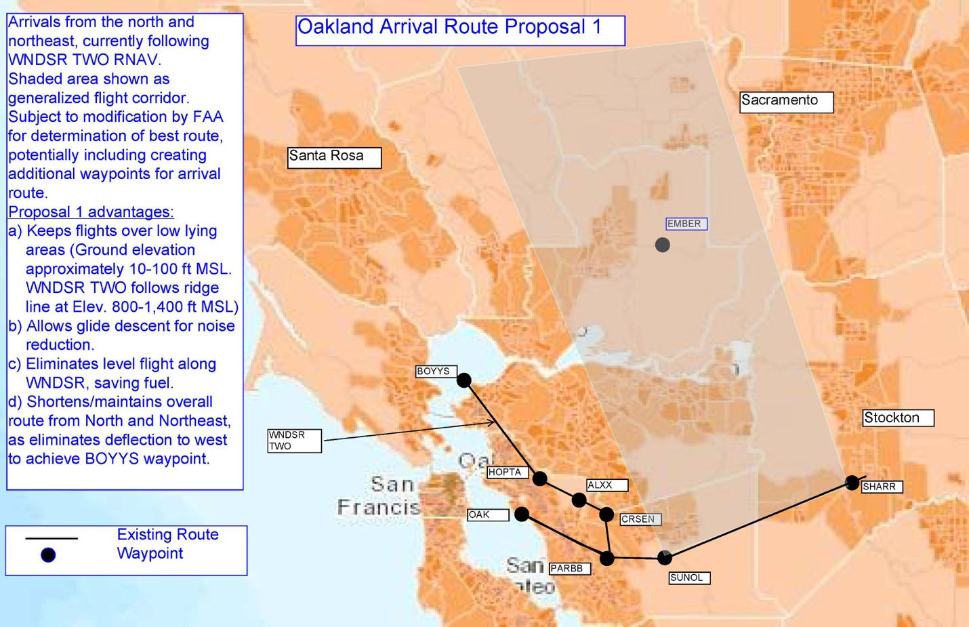
OAK Proposal – Move the WNDSR Arrival
Alternative One - Preferred
• Bring traffic southward at altitudes greater than 10,000 ft. over low-lying (10-100 feet MSL)over sparsely populated areas in the Central Valley to join the established OAK MADWIN and OAKES arrival tracks as well as the current vectored arrivals that WNDSR uses very near the airport.
• Enables the NextGen goal of quieter, idle power glide descents, that WNDSR can never deliver.
• Enables the NextGen goal of fuel efficiency, that WNDSR can never deliver.
• Shortens flight paths by eliminating the current deflection to the west to achieve the BOYSS waypoint.
• Removes potential conflicts between OAK arrivals and SFO/OAK departures in crowded, stacked airspace.
Higher population density reflected by darker colors.

Slide 13
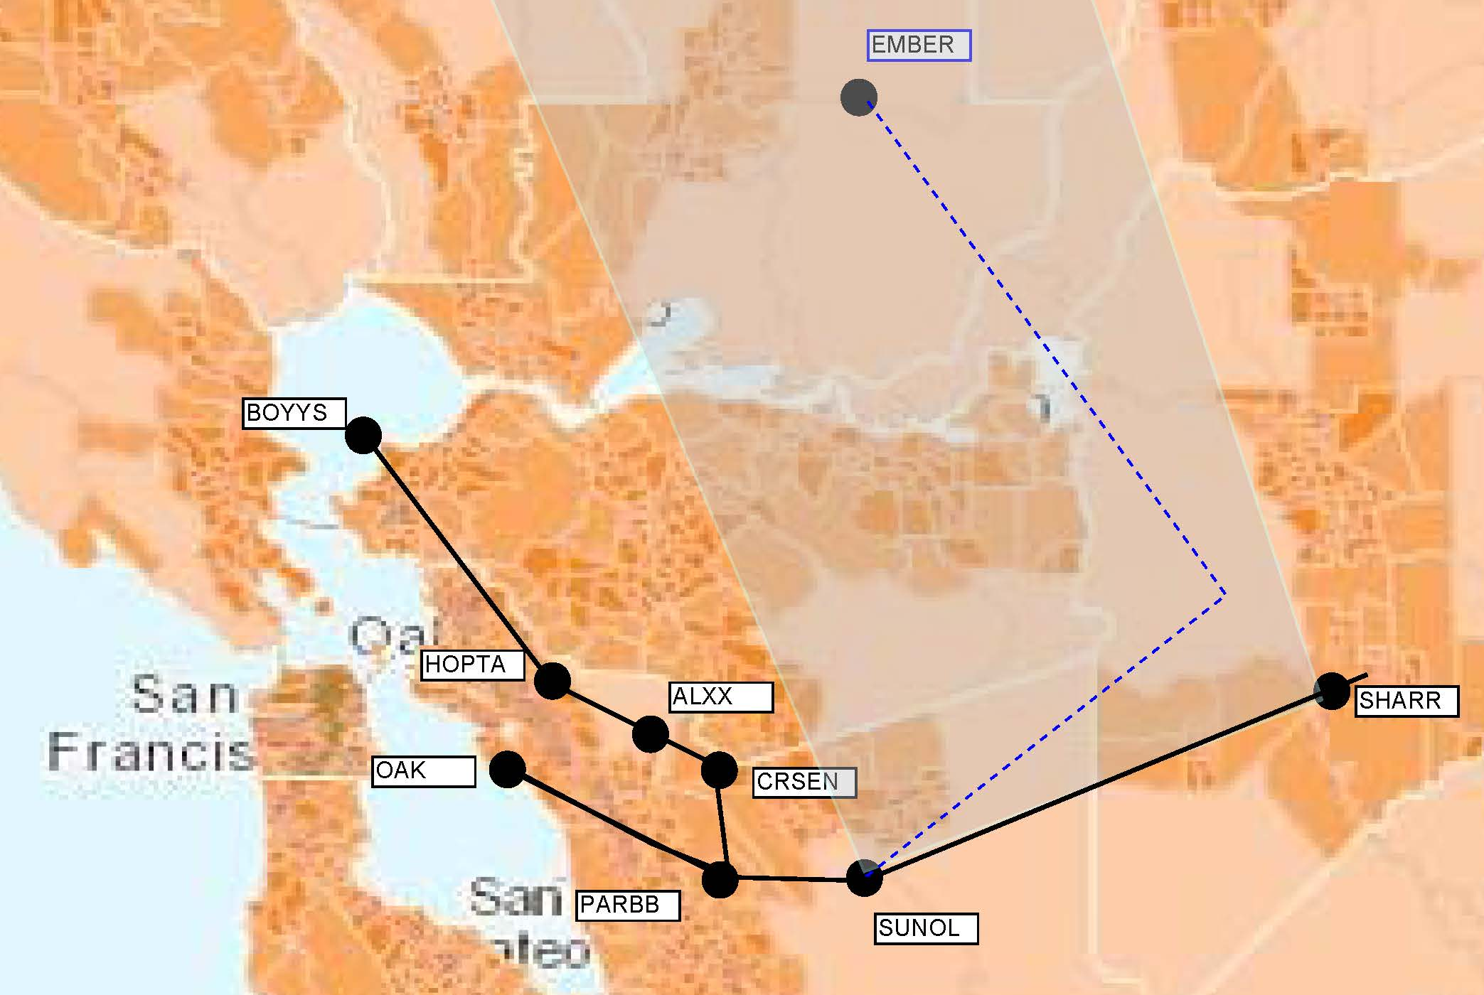
OAK Proposal – Move the WNDSR Arrival
Altitude and descent procedure make a big difference.
Ambient noise in a quiet suburban area is 45-50 dB for comparison.
Moving WNSDR is not noise shifting. Noise shifting is taking noisy conditions and recreating those same noise levels someplace else.
Aircraft at high altitude and descending on a near idle quiet descent to 12,000 feet MSL as they approach the existing OAK arrival. Ground level is 10 to 100 feet MSL. Estimate < 55dB
Aircraft anticipated to be at altitudes near 12,000 ft MSL as they approach the SHARR waypoint. Estimate <55dB
WNDSR
Aircraft altitudes commonly
down to 3000 feet AGL in
level flight under thrust for
23 nautical miles.
Measured at 76dB plus.
Aircraft join existing Oakland arrival track at or before the SUNOL waypoint.
Estimate 55-62 dB
Conservative noise levels in dB’s estimated using the loudest part of a flight for planes as large as A380’s and 747’s. Data accessed from the NATS website on January 16, 2017.

Slide 14
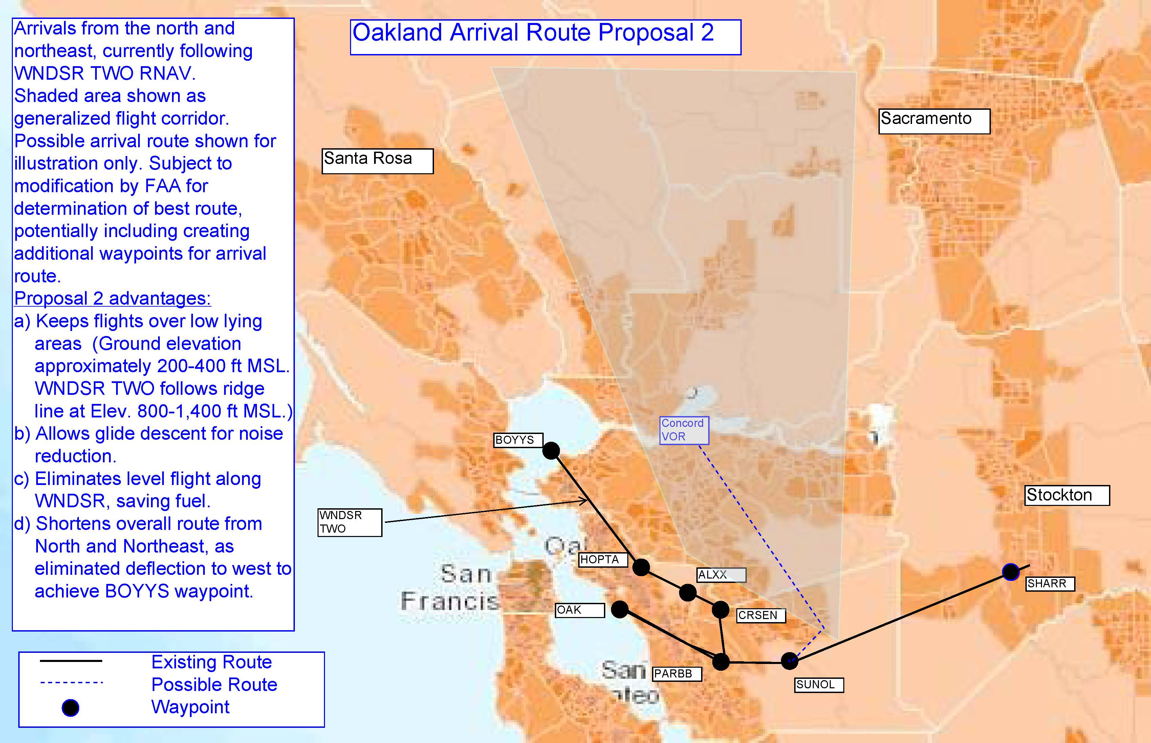
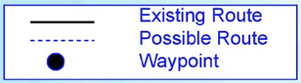
OAK Proposal – Move the WNDSR Arrival
Alternative Two
• Bring traffic southward over low-lying (200-400 feet MSL) areas at altitudes greater than 10,000 feet. Follows industrial areas and California I-680 highway to join the established MADWIN and OAKES arrival tracks.
• Enables NextGen quieter, idle power glide descents.
• Enables the NextGen goal of fuel efficiency WNDSR can’t.
• Should shorten flight paths by eliminating the current deflection to the west to achieve the BOYSS waypoint.
• Increases safety by removing potential conflicts between OAK arrivals and OAK/SFO departures in crowded, stacked airspace.
Altitude above 10,000 ft. MSL Estimate at or less than 55dB
Altitudes at or greater than 6,000 ft MSL as aircraft join existing arrival route.
Estimate 55-62dB
Higher population density reflected by darker colors. NATS dB estimates.

Slide 15
OAK Proposal Modify OAKLAND NINE
The OAKLAND NINE is a standard daytime departure for aircraft heading to destinations to the north.
Noise Issues
• Aircraft do not fly a consistent track that could be designed to reduce noise for Alameda.
• Aircraft departing for destinations eastward turn once they reach 3000 feet MSL. They are under thrust and at lower altitudes over Oakland resulting in increased noise impacts.
• NextGen technology and procedures can be leveraged for this departure to provide a consistent solution for noise relief to East Bay communities.

Slide 16
OAK Proposal
Modify OAKLAND NINE
Short Term
• To keep planes further away from the Alameda shoreline, Air Traffic Control to direct departing planes to turn left to a heading of 280° until they reach the OAK 4 DME arc and then aircraft can proceed on the published OAKLAND NINE departure.
• Aircraft not be turned eastward over Oakland until they reach 5000 feet MSL in altitude for better noise mitigation as opposed to the current 3000 feet MSL.
Long Term
• Request the FAA consider creating a NextGen RNAV published departure that replicates the short term proposals to OAKLAND NINE above.

Slide 17
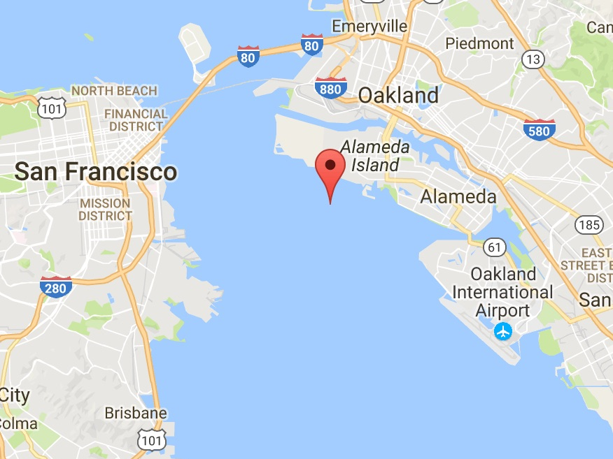
OAK Proposal
Modify the CNDEL Departure
The CNDEL RNAV departure is used by aircraft heading for destinations to the south.
Noise Issues
Aircraft come close to Bay Farm Island and Alameda shorelines.
CNDEL
Waypoint
LEJAY
Waypoint
Turn south
to next
waypoint
NOTE: Lines and waypoints on map are approximate representations of published charts.

Slide 18
OAK Proposal
Modify the CNDEL Departure
Short Term Proposals
• To get planes further away from the Alameda shoreline sooner, Air Traffic Control can direct departing planes to turn left to a heading of 280° until they reach the OAK 4 DME arc instead of the LEJAY waypoint, and then aircraft can proceed on the published CNDEL departure.
Long Term Proposals
• Adjust the published CNDEL RNAV track to have aircraft further away from the Alameda shoreline sooner by adjusting the LEJAY waypoint to overlay proposed Short term solution of a 280° heading from OAK to the OAK 4 DME arc as noted above. Adjust published procedure so that aircraft then proceed on the current published CNDEL departure from that arc.

Slide 19
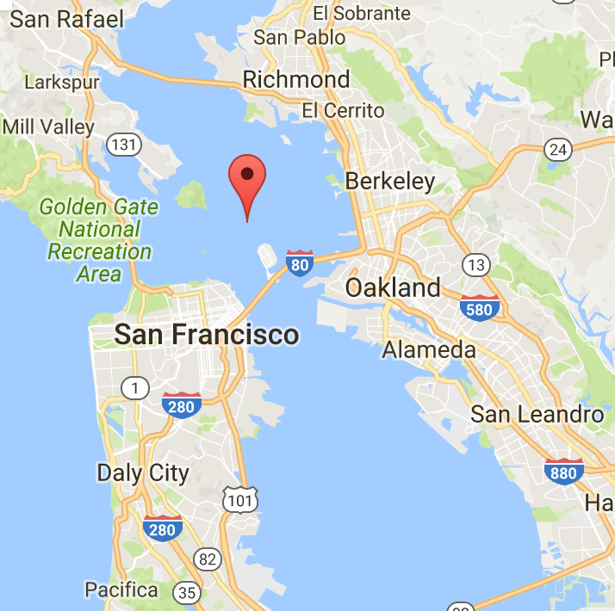

SFO Proposal
Modify the NIITE Departure
REBAS
Intersection
NIITE is the NextGen RNAV track used during night time hours to overlay the prior QUIET standard departure used before NextGen for planes heading north and northeast from SFO.
Noise abatement procedures are designed to reduce noise impact by keeping planes over the bay until they reach higher altitudes (>8000 feet MSL) at Point Richmond and can turn eastward.
Noise Issues:
The overwhelming majority of aircraft are granted early turns at lower altitudes well south of the REBAS intersection over densely populated Alameda, Oakland, Berkeley and El Cerrito during quiet, night time hours. This circumvents noise abatement goals. For example, an FAA study showed 35% of flights even turned eastward well before the NIITE waypoint in June 2016. (FAA Select Committee Presentation, July 22, 2016)
NIITE Waypoint
SFO
NOTE: Lines and waypoints on map are approximate representations of published charts.

Slide 20
SFO Proposal
Modify the NIITE Departure
Proposed Solutions
• Issue an FAA Air Traffic Control directive that aircraft fly the full NIITE departure
to REBAS during night hours for noise abatement purposes unless safety dictates otherwise.
• Adjust the REBAS waypoint location offshore to better mitigate noise at Point Richmond.
• Adjust night time hours to provide a longer period of quiet hours for noise relief:
  Current: 10pm – 7am Monday through Saturday and 10pm – 8am on Sunday
  Propose: 9pm – 9am seven days a week

Slide 21
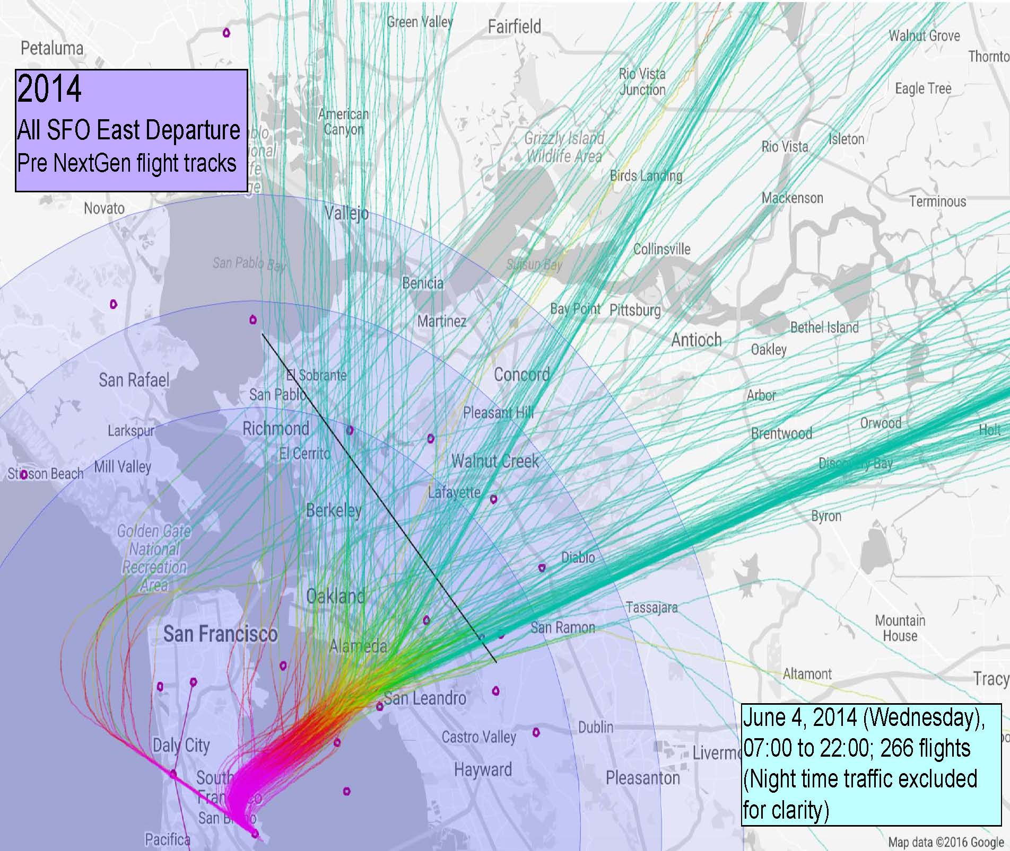
SFO Proposal
Modify the TRUKN Departure
Pre NextGen
Prior to NextGen, SFO departures to the north and east were vectored over a wide corridor from El Sobrante to San Leandro with some notable concentrations of traffic. Many aircraft made their turns over the Bay prior to reaching Alameda. There were no RNAV tracks for these departures.
Sample day of Pre NextGen vectored departures from SFO

Slide 22
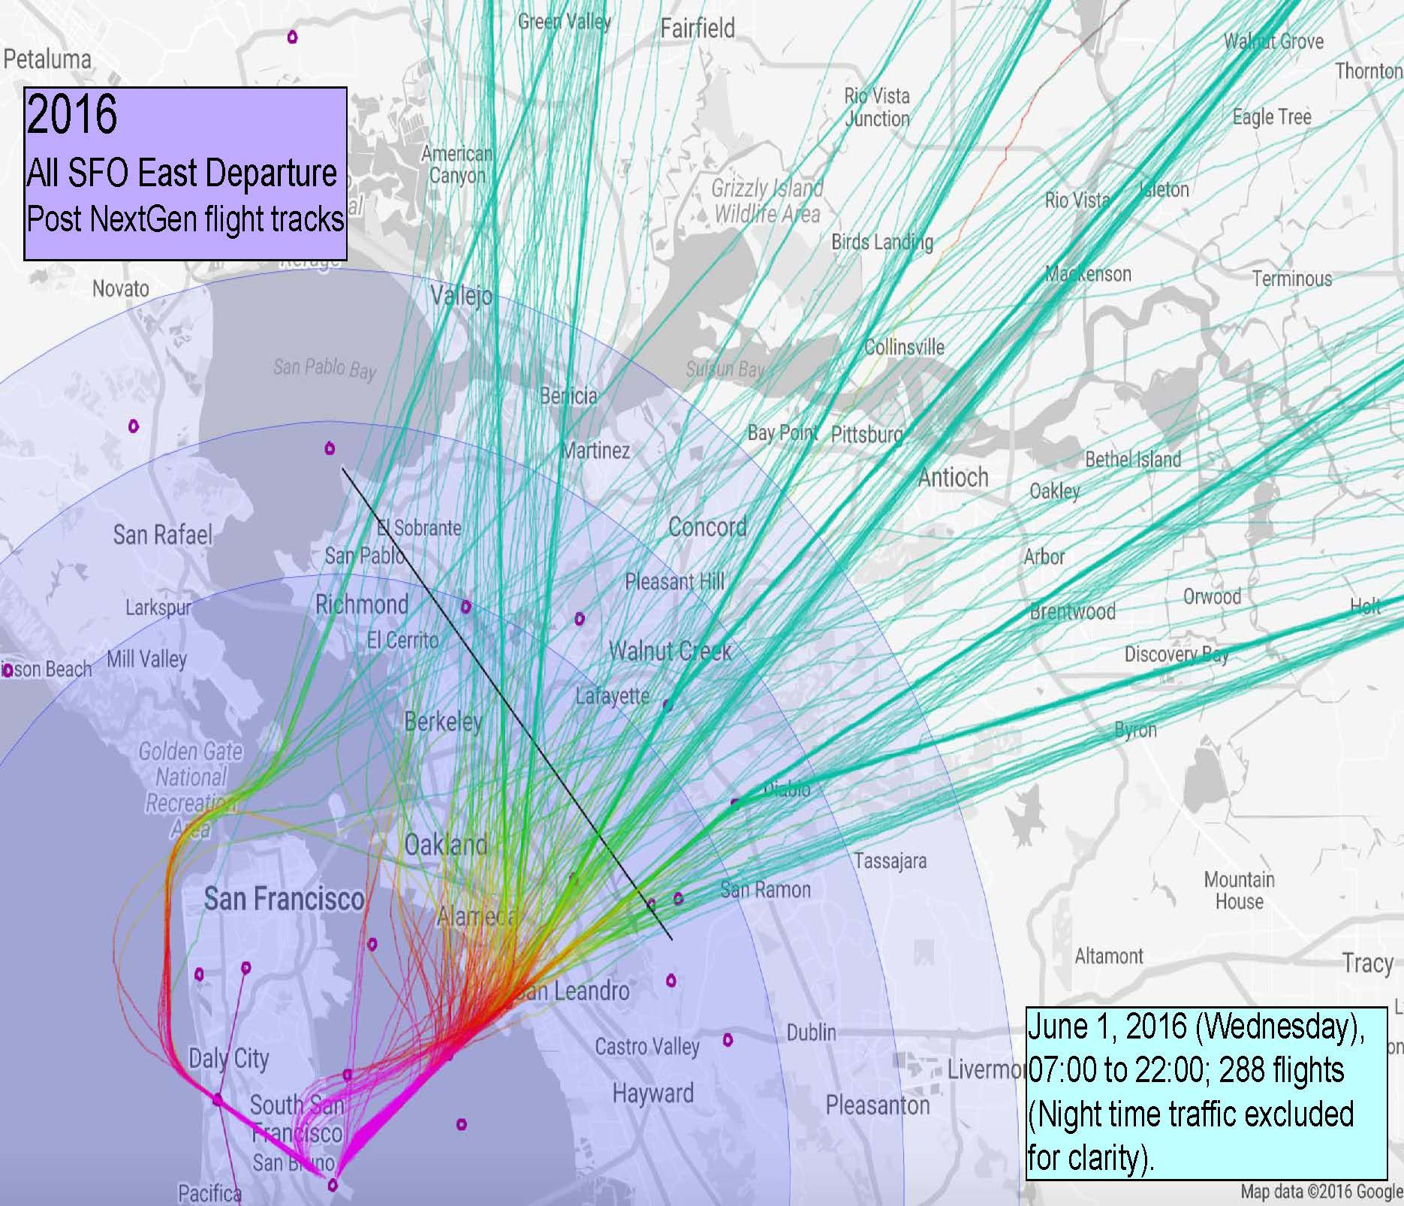
SFO Proposal – Modify TRUKN
Post NextGen
• TRUKN is a new NextGen RNAV for SFO departures to the north and east.
• TRUKN consists of a waypoint at Oakland Airport together with four splayed tracks called GRTFL, DEDHD, HYPEE, and COSMC.
• The proposal informally groups them as:
GRTFL and DEDHD = TRUKN North
HYPEE and COSMC = TRUKN East
DEDHD
GRTFL
HYPEE
COSMC
TRUKN Waypoint at OAK
SFO
Sample day of post NextGen vectored eastbound departures from SFO

Slide 23
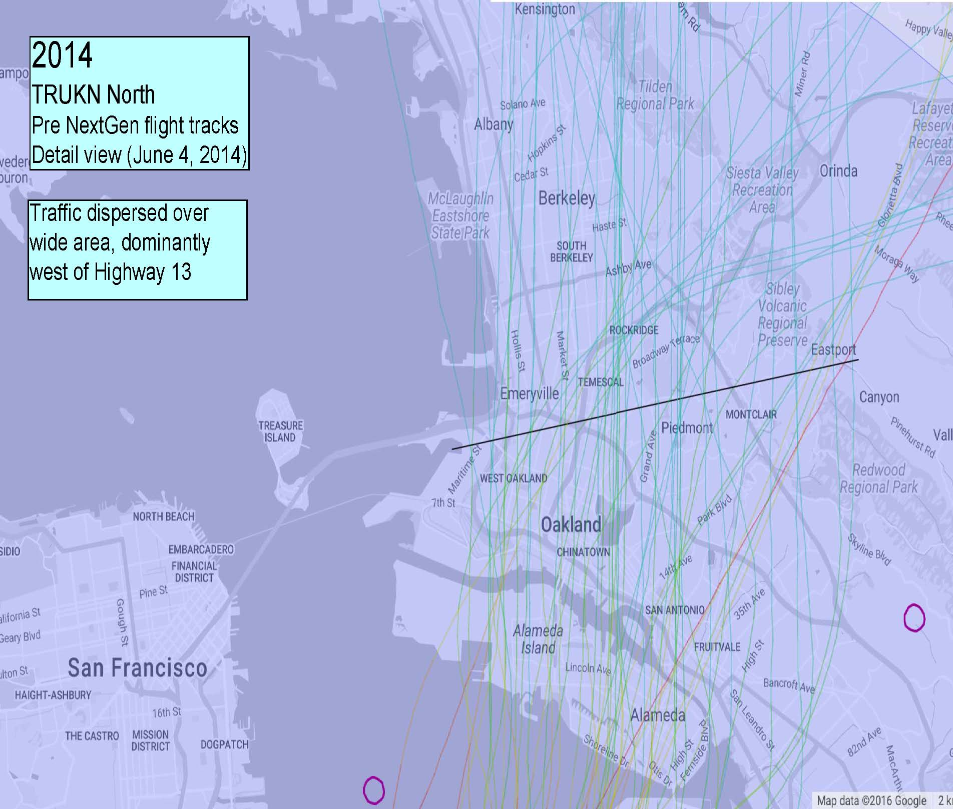
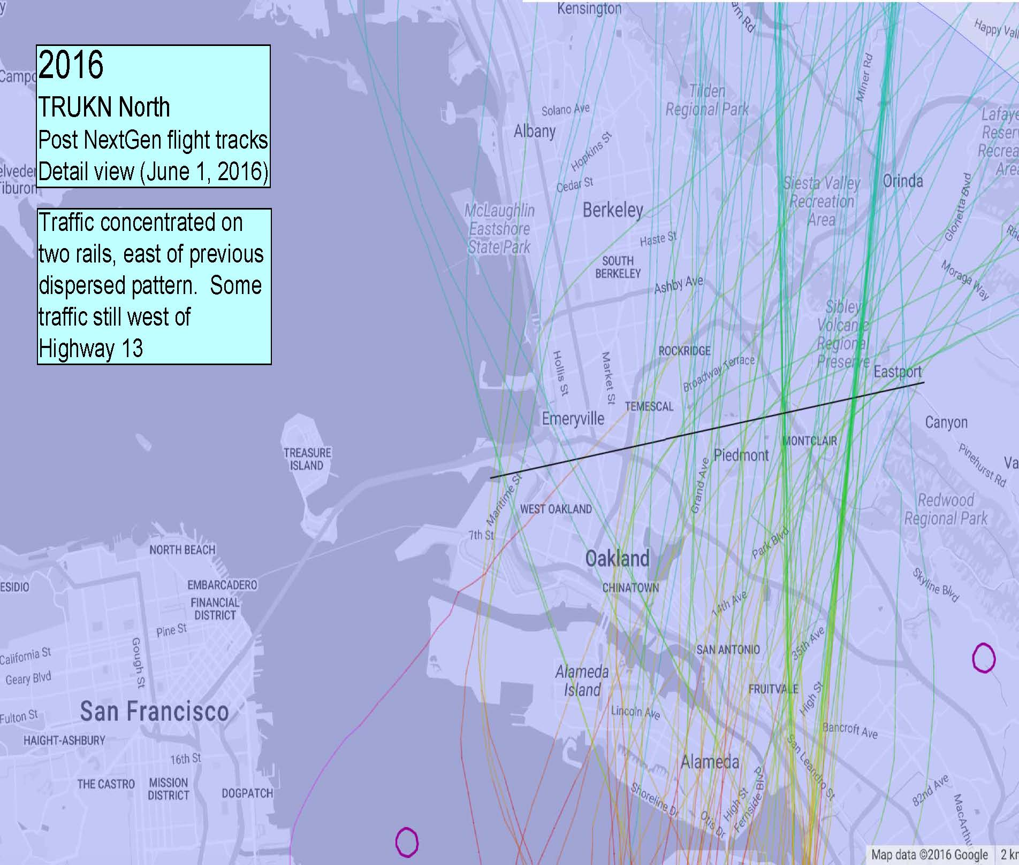
SFO Proposal
TRUKN North
What did NextGen change in the TRUKN North area?
NextGen shifted and concentrated traffic eastward where it did not exist prior to NextGen.

Slide 24
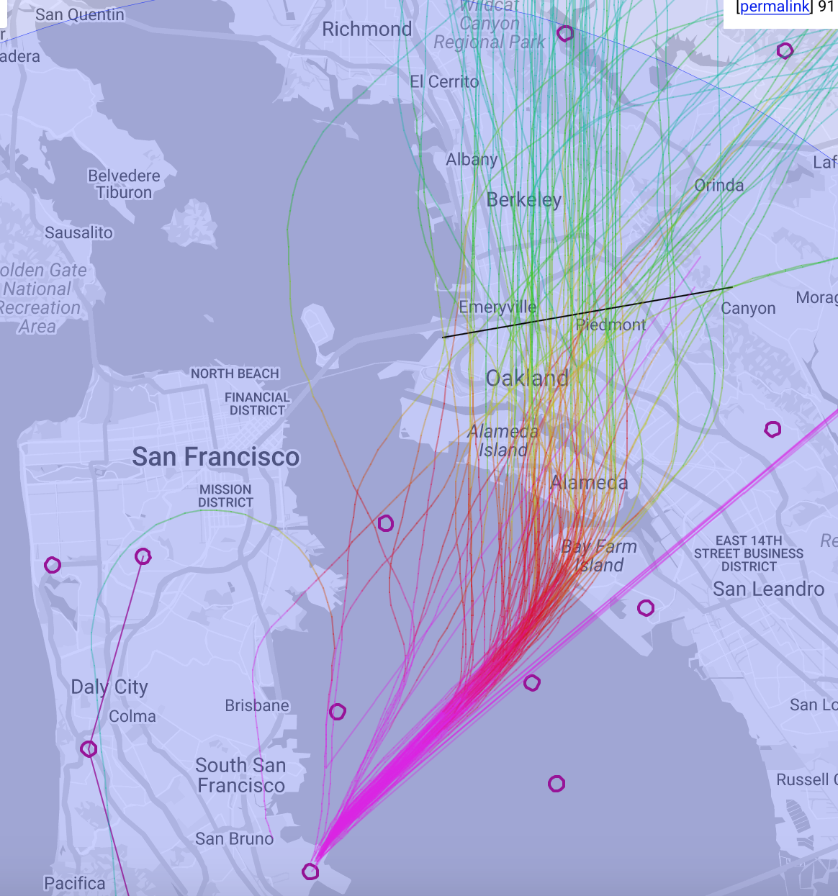
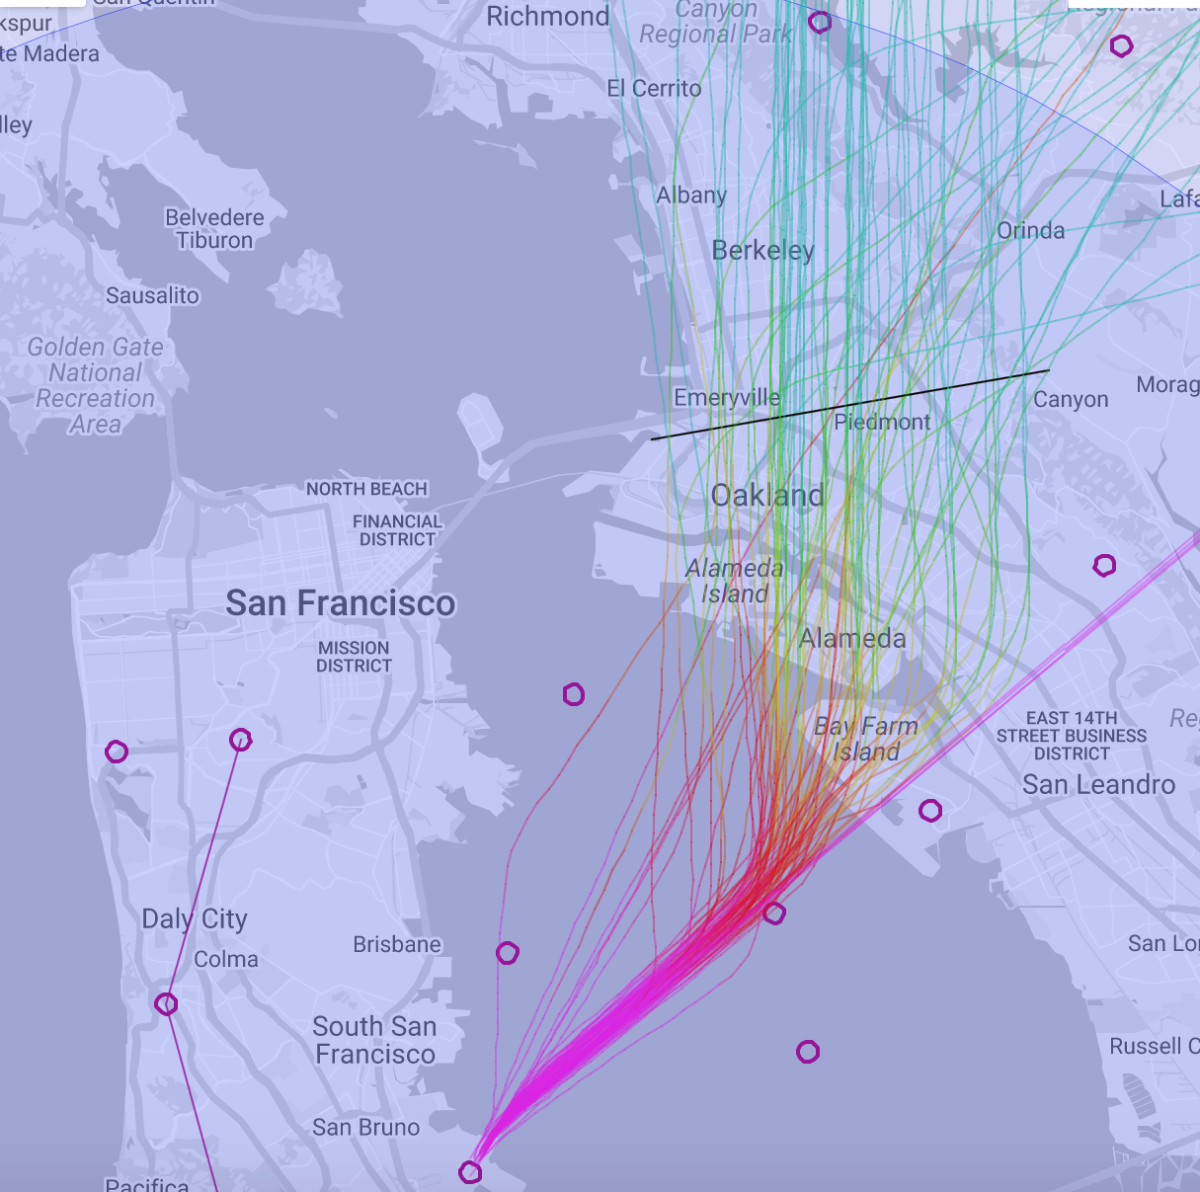
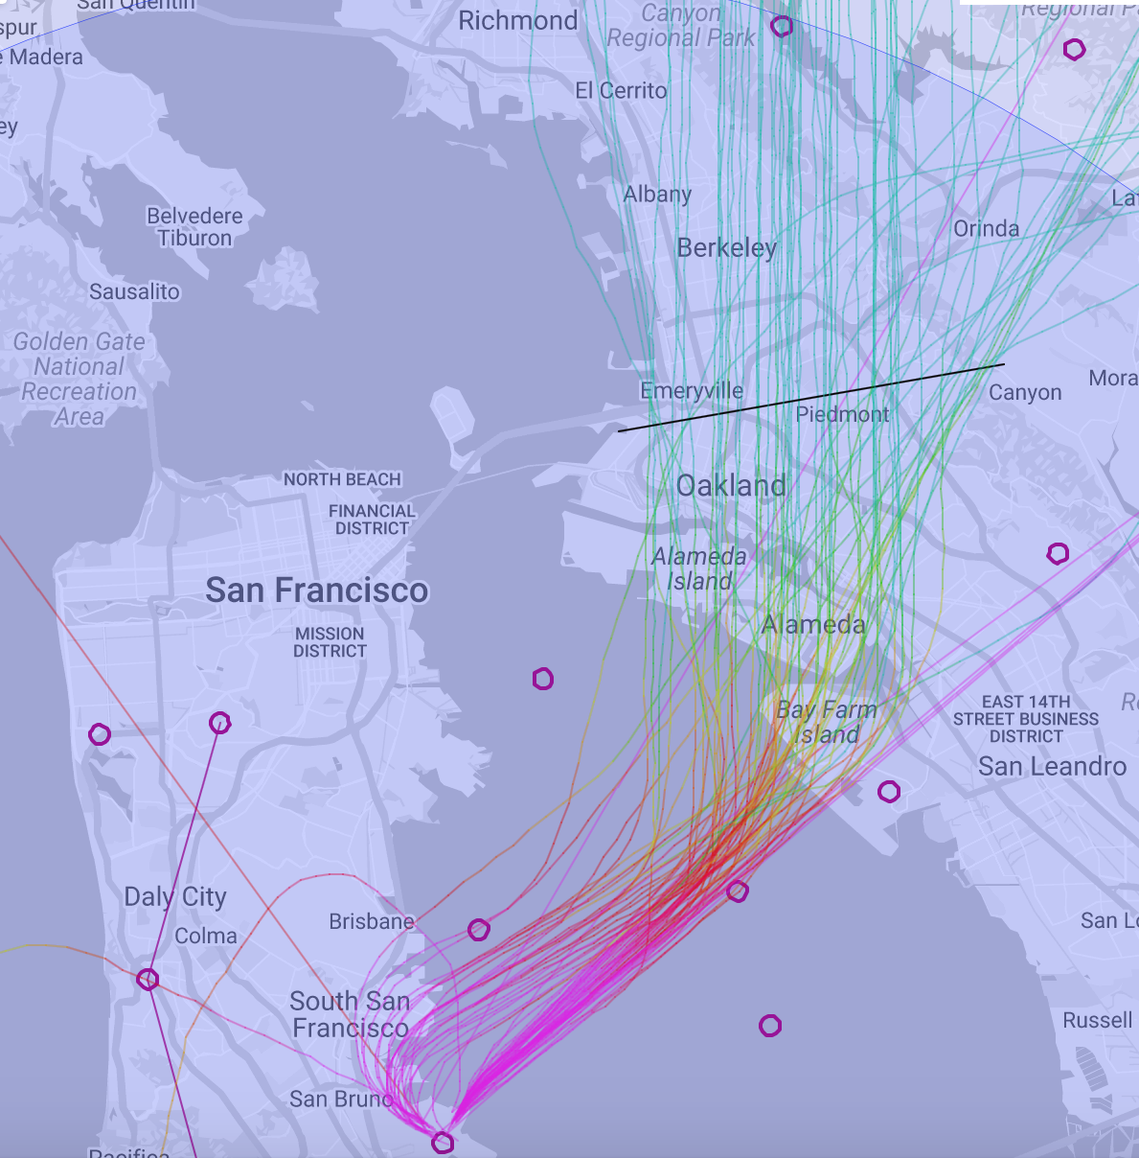
SFO Proposal
TRUKN North
More examples showing how most Pre NextGen traffic was well-established west of the current GRTFL and DEDHD tracks.
Wednesday
July 9, 2013
91 Flights
Wednesday
April 9, 2014
79 Flights
Wednesday
May 7, 2014
70 Flights
Arrows indicate current GRTFL and DEDHD tracks overlaying Pre NextGen traffic patterns

Slide 25
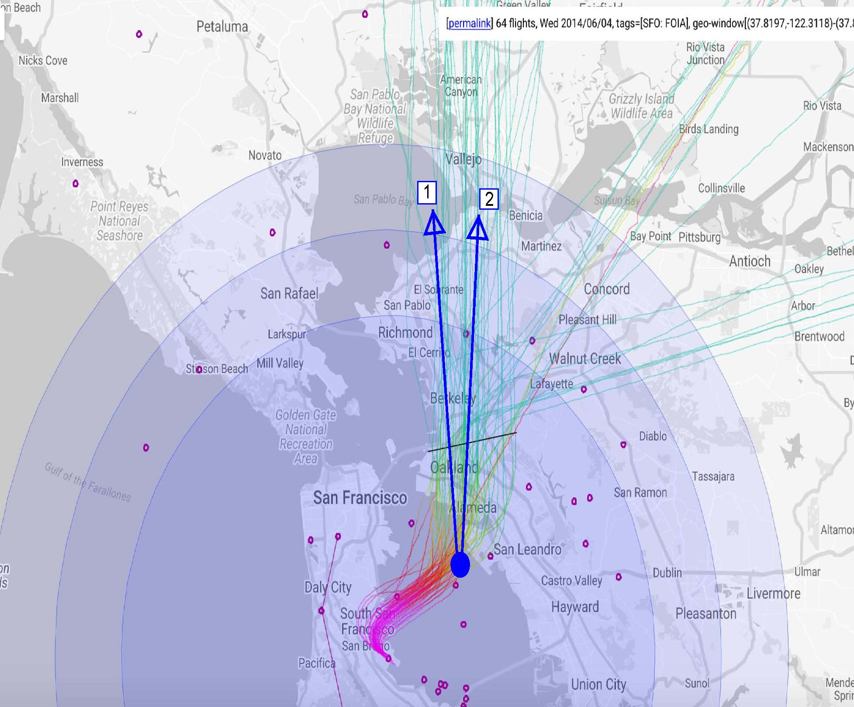
SFO Proposal
TRUKN North
Proposal-
• Restore historic traffic concentrations that communities grew and developed under.
• Replace GRTFL and DEDHD with new RNAV tracks to a westward location to restore and echo previous traffic concentrations.
Possible
replacement
RNAV tracks
Adjust TRUKN as feasible
June 4, 2014 flight tracks shown to exemplify pre NextGen traffic

Slide 26
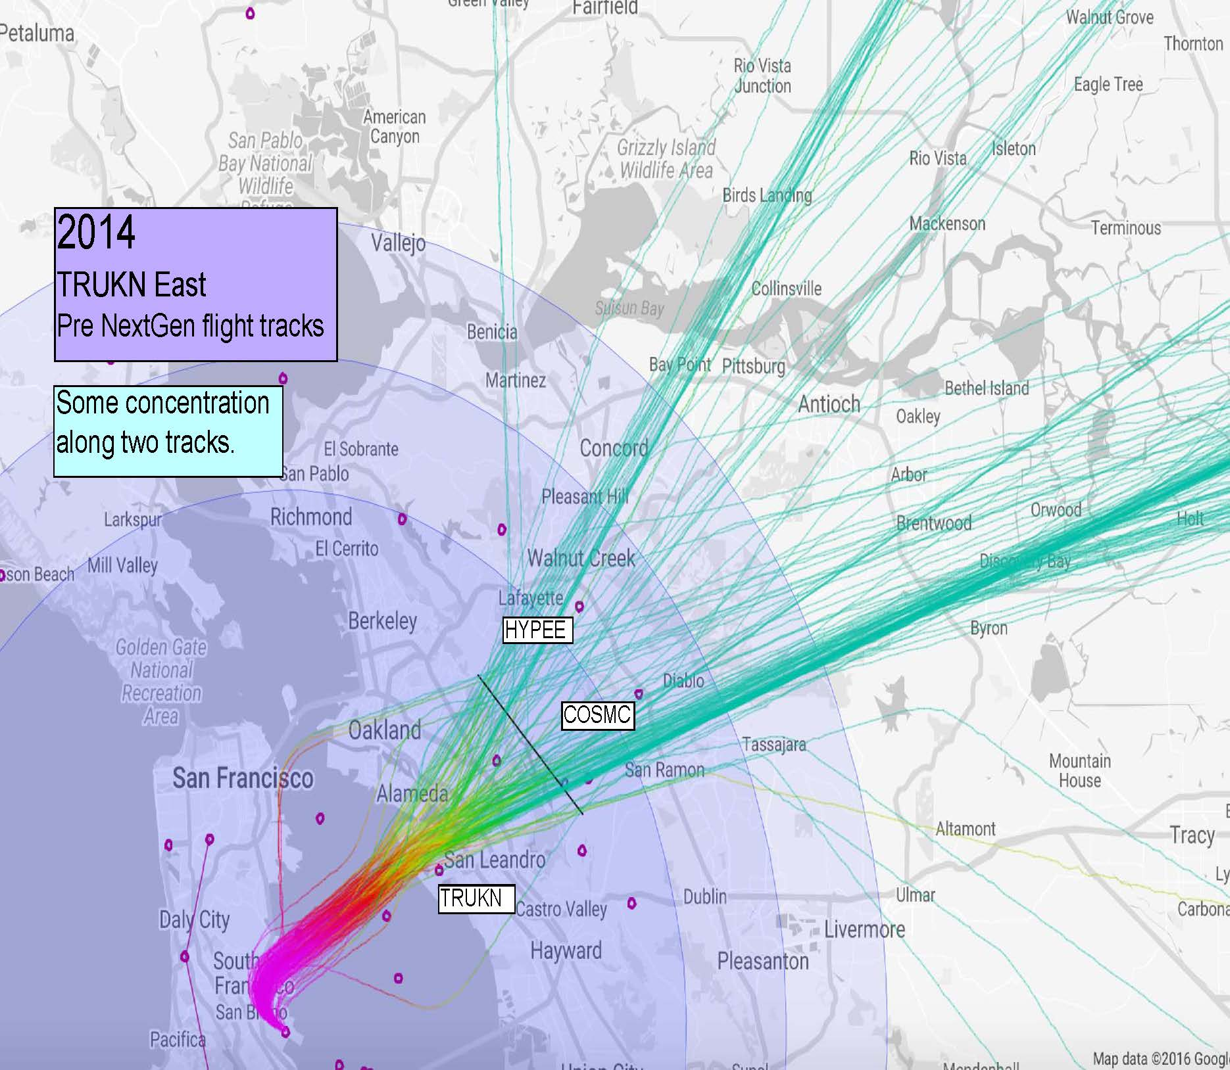
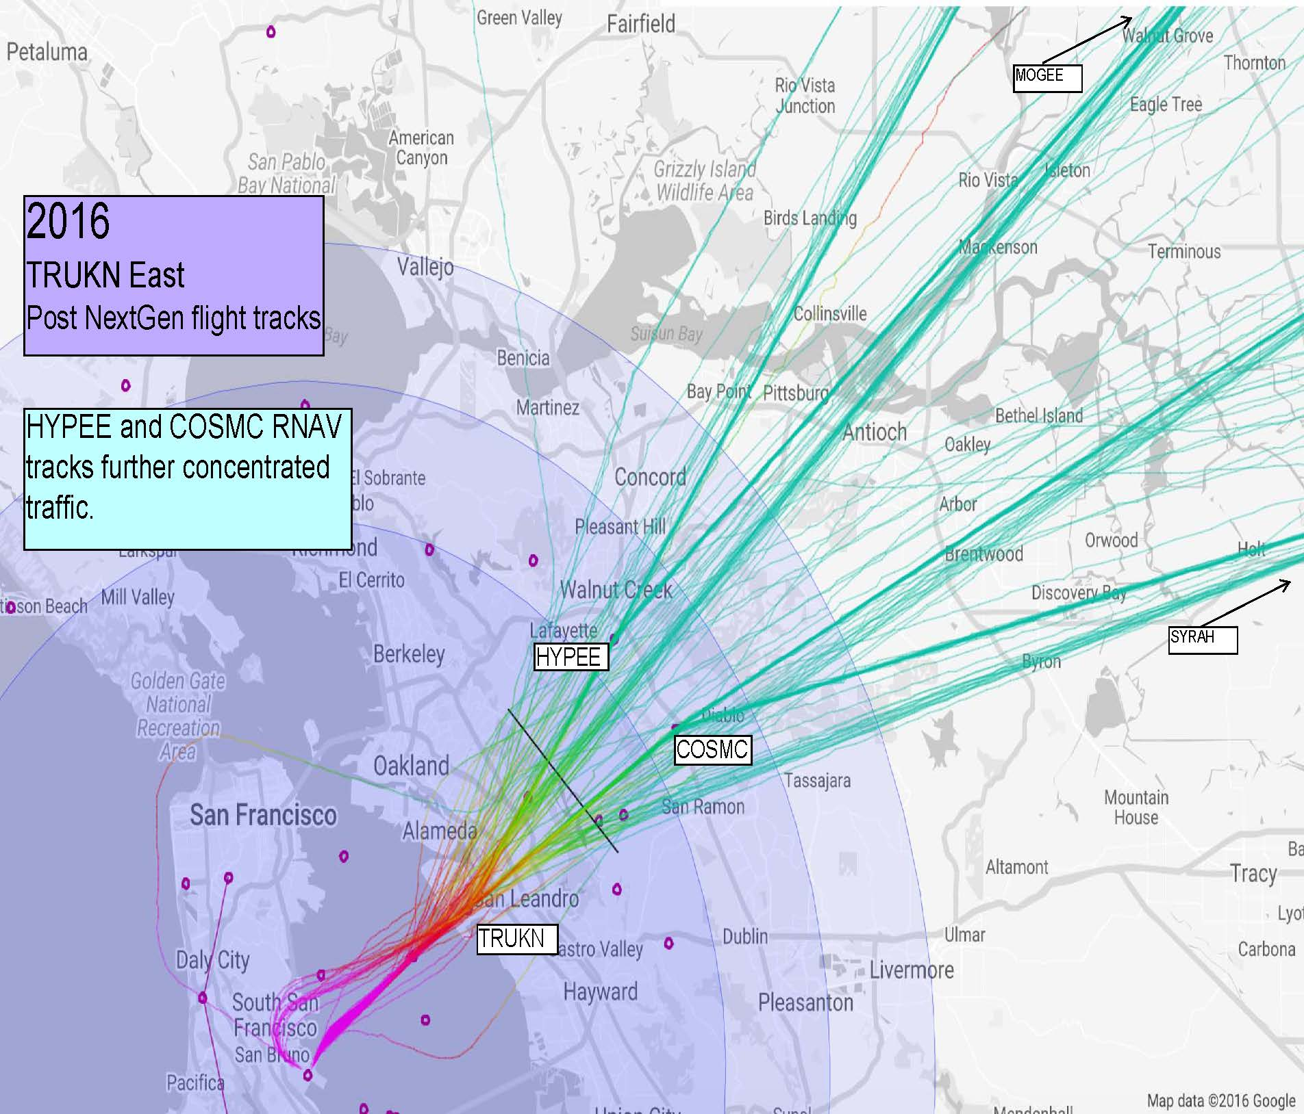
SFO Proposal
TRUKN East
What did NextGen change in the TRUKN East area?
Wednesday, June 4, 2014, 184 Flights
Wednesday, June 1, 2016, 175 Flights
NextGen further concentrated traffic and shifted the northerly corridor southward

Slide 27
SFO Proposal
TRUKN East
Proposal
• Consider an additional track to the area of the existing COSMC and HYPEE RNAV tracks.
and
• Direct Air Traffic Control to vector traffic along all resulting tracks in the TRUKN East area to better echo and restore historical dispersion of SFO departing traffic.

Slide 28
Conclusion
• Mitigation options exist that work to
  Maintain and increase aviation safety
  Respect and improve efficient fuel and airspace use
  Create a fairer distribution of noise.
  • The Supplemental proposals are generalized. It’s understood the FAA may make and suggest modifications to the proposed mitigations in that document.
• Analysis may identify additional procedures and issues to be addressed.
• The Supplemental proposal document requests the FAA move expeditiously towards resolution and any and all modifications and requests be communicated to the NextGen Subcommittee in a timely and transparent manner to keep the process moving forward as quickly as possible.

